Slide 1
Mobile Robot
Take Home Exam
Jeong-Yean Yang
2020/10/21

Slide 2
Take Home Exam.
Due To 10/29
Submission by E-mail, muhw03@gmail.com
Submission by E-mail, muhw03@gmail.com
Submission by E-mail, muhw03@gmail.com
Power point report with source code, Video or Captured Image.

Slide 3
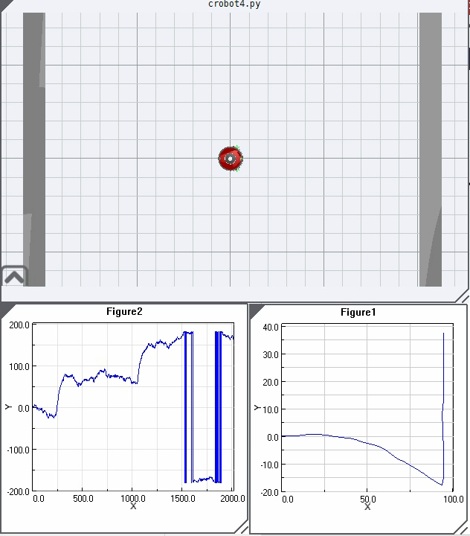
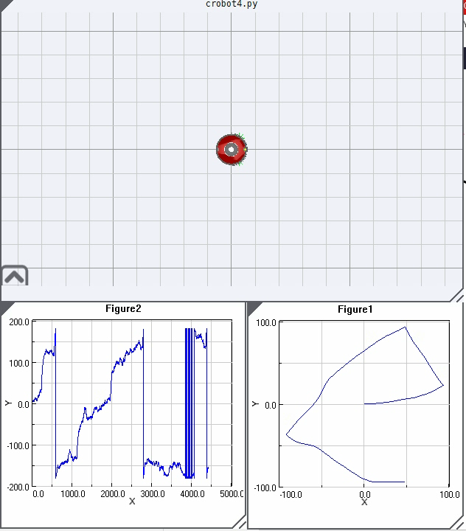
Prob. 1. Your BEST Strategy ex/robot/crobot
Use crobot~crobot4

Slide 4
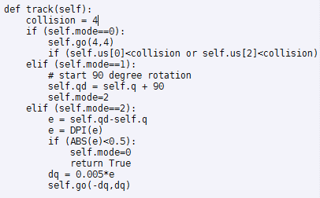
ex/robot/crobot4
Center : us[0]
Right : us[2]
90 degree to left is the strategy here.
Find your best solution
At least, 2 minute results.

Slide 5
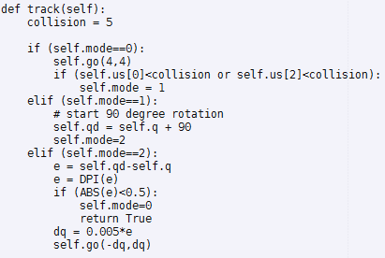
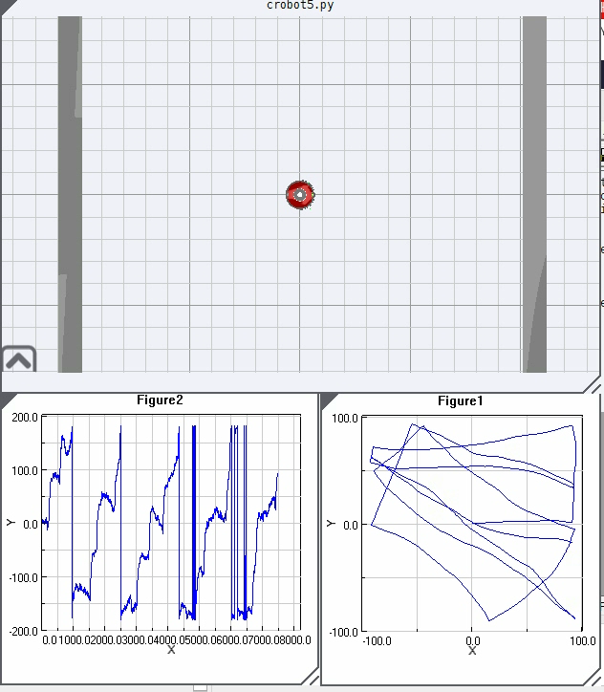
ex/robot/crobot5
Increasing Collision Margin
Collision=5 makes a robot NOT to be stuck on walls.
But, cleaning performance becomes bad.

Slide 6
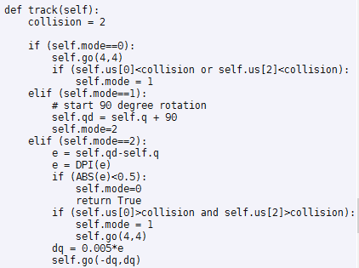
ex/robot/crobot6
Modifying 90 degree rotation
crobot5
crobot6
Crobot5 waits until a robot rotates 90 degree.
Crobot6 does not wait. Without obstacles, a robot starts to go straight.

Slide 7
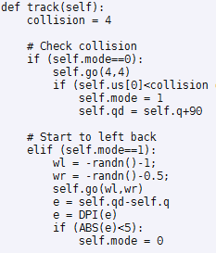
Prob. 2. Roomba-like Strategy
Tuning of Left backward(ex/robot/crobot7)
|WL|>|WR| for left backward turn

Slide 8
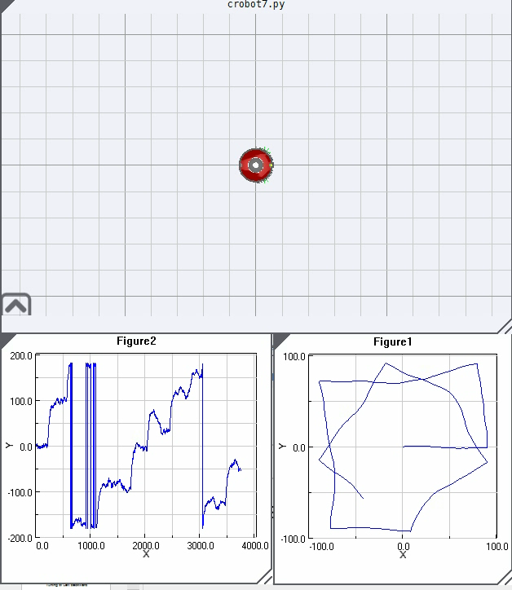
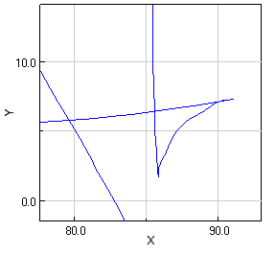
Result of crobot7
|WL|>|WR| for left backward turn
Backward moves

Slide 9
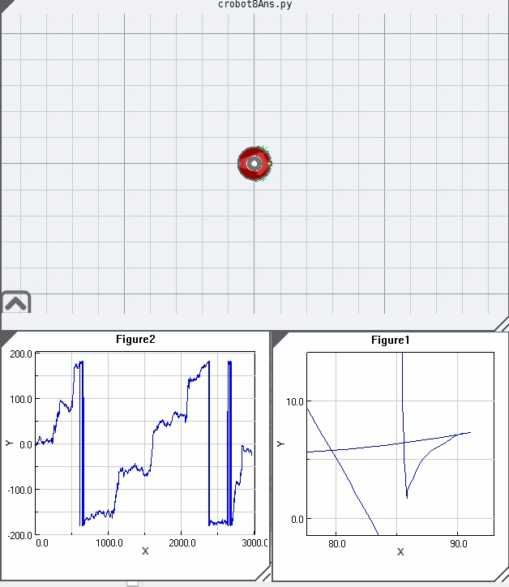
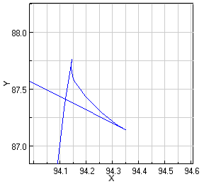
Prob. 2. Modify ex/robot/crobot8
Show your result

Slide 10
In my case, Two types of Turning Strategy
If Center has obstacles,
Do Turing 90 degree.
If Right has obstacles,
Do Turing 45 degree.
This strategy makes a robot to do smooth turning.

Slide 11
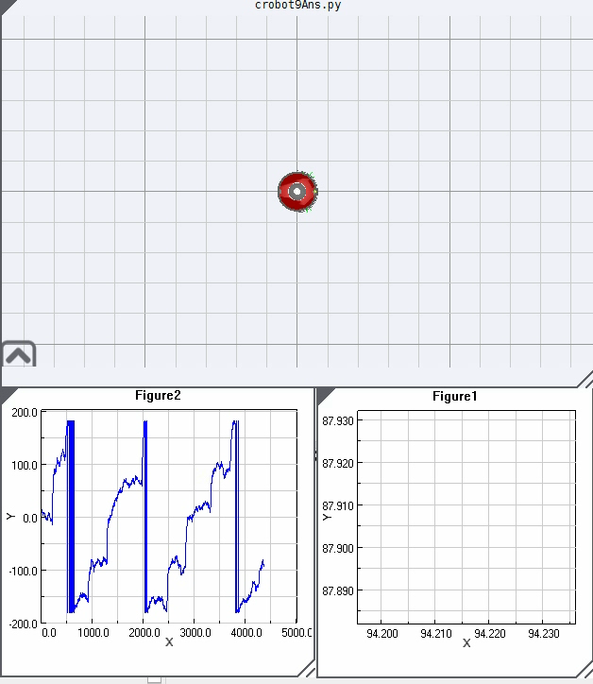
Prob. 3. Mission: Basic Wall Following
However, crobot8 does NOT follow walls.
Let’s go back to the first definition
Forget complex theory
With a slight modification, wall following can be implemented.
In my case, one digit was changed… ^^
Hint : Roomba is using Spiral motion + Left backward turn

